Slide 1
PRESIDENCY UNIVERISTY, BENGALURU, School of Engineering
Computer Organization and Architecture
CSE 2009
Module-2: Instruction Set Architecture and Memory Unit

Slide 2
Addressing modes
The different ways in which the location of an operand is specified in an instruction are referred to as addressing modes.
We can access an operand by specifying the name of the register or the address of the memory location where the operand is located.
Register Mode:
The operand is the contents of a processor register, the name(address) of the register is given in the instruction.
e.g. MOV R1,R2
The instruction copies the contents of register R1 to register R2.

Slide 3
Absolute mode:
The operand is in a memory location; the address of this location is given explicitly in the instruction.(In some assembly languages, this mode is called direct).
The instruction uses two modes.
E.g. MOV LOCA,R2
Processor registers are used as temporary storage locations where the data in a register are accessed using register mode.

Slide 4
Immediate mode:
The operand is given explicitly in the instruction.
e.g. MOV 200_{immediate},R0
The instruction places the value 200 in the register R0.
The immediate mode is only used to specify the value of a source operand. Using a subscript to denote the immediate mode is not appropriate in assembly languages.
A common convention is to use the sharp sign (#) in front of the value to indicate that this value is to be used as an immediate operand.
Hence we write the instruction above in the form
MOV #200,R0

Slide 5
Indirect mode:
In this addressing mode, the instruction does not give the operand or its address explicitly. instead it provides information from which the memory address of the operand can be determined. we refer to this address as the effective address(EA) of the operand.
The effective address of an operand is the contents of register or memory location whose address appears in the instruction.
To execute the add instruction in the figure(A) the processor uses the value B, which is in the register R1, as the effective address of the operand. the value read is desired operand, which the processor adds to the contents or register R0.

Slide 6
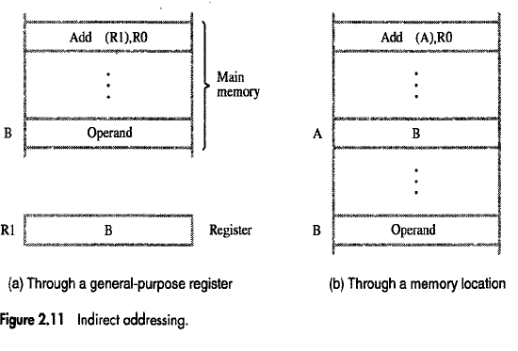

Slide 7
Indirect addressing through a memory location is also possible as shown in the figure(b). In this case processor first reads the contents of memory location A, then requests a second read operation using the value B as an address to obtain the operand.
The register or memory location that contains the address of an operand is called a pointer.

Slide 8
Index mode :
The effective address of the operand is generated by adding a constant value to the contents of a register.
The register used may be either a special register provided for this purpose, or more commonly, it may be any one of a set of general-purpose registers in the processor.
In either case, it is referred to as an index register.
We indicate the index mode symbolically as
X(R_{i})
X→ denotes the constant value in the instruction, Ri is name of the register involved.
Effective address of the operand is given by
EA = X+[Ri]

Slide 9
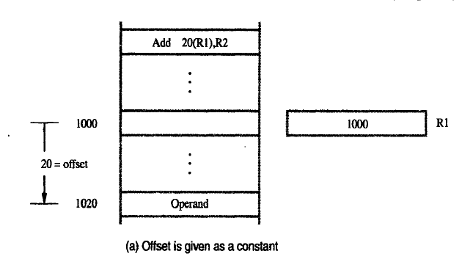

Slide 10
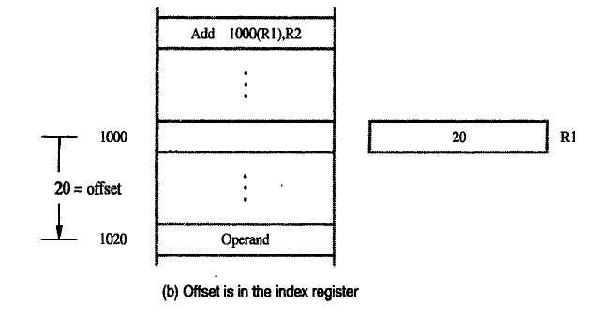

Slide 11
Figure illustrates two ways of using the index mode.
In figure A the index register R1, contains the address of a memory location and the value X defines an offset(also called displacement) from this address to the location where the operand is found.
An alternative use is illustrated in figure B. Here, the constant X corresponds to a memory address, and the contents of the index register define the offset to the operand.
In either case, the effective address is the sum of the two values, one is given explicitly in instruction and the other is stored in a register.

Slide 12
Base with Index Mode
In this addressing mode Effective Address is the sum of two registers.
Syntax:
(R_{i},R_{j})
Effective Address:
EA= [R_{i}]+[R_{j}]
The first register is called Index Register.
The second register is called Base Register.

Slide 13
Base with Index and Offset
In this addressing mode effective address is the sum of the constant(X) and the contents of the two registers.
Syntax:
X(R_{i},R_{j})
EA=[R_{i}]+[R_{j}]+X

Slide 14
Relative Addressing:
We have discussed the index mode using general-purpose register.
A useful version of this obtained if program counter(PC) is used instead of a general purpose register.
Then X(PC) can be used to address a memory location that is X bytes away from the location pointed by the program counter.
EA=[PC]+X
The effective address is determined by the index mode using the program counter in the place of the general purpose register.
Its common use is to specify the target address in branch instructions. An instruction such as
Branch>0 Loop
Causes program execution to go to the branch target location identified by the name LOOP if the branch condition is satisfied. this location can be computed by specifying it as an offset from the current value of the program counter

Slide 15
Additional Modes
So far we have discussed the six basic addressing modes- register, absolute, immediate, index, indirect and relative.
Many computers provide two additional modes:
1) Autoincrement Mode
2) Autodecrement Mode
Autoincrement mode:
The effective address of an operand is contents of register specified in the instruction. After accessing the operand, the contents of the register are automatically incremented to point to the next item in the list.
We denote autoincrement mode by putting the specified register in parentheses, to show that contents of register are used as the effective address.

Slide 16
The autoincrement mode is written as
(Ri)+
Autodecrement mode:
The contents of a register specified in the instruction are first automatically decremented and are then used as the effective address of the operand.
We denote the autodecrement mode by putting the specified register in parentheses, preceded by a minus sign to indicate that the contents of the register are to be decremented before being used as the effective address. Thus we write
-(Ri)

Slide 17
STACK
Data operated on by a program can be organized in a variety of ways.
Now, we consider the important data structure known as STACK.
A stack is a list of data elements usually words or bytes with the accessing restriction that elements can be added or removed at one end of the list only, this end is called TOP of the STACK, and the other end is called the bottom.
The structure sometimes referred to as a pushdown stack or last –in first –out(LIFO). That is the last data item placed on the stack is the first one removed when retrieval begins.

Slide 18
PUSH:
Placing a new item on the stack.
POP:
Removing the top item from the stack.
Assume that the first element is placed in location bottom, and when new elements are pushed onto the stack, they are placed in successively lower address locations. We use a stack that grows in the direction of decreasing memory addresses in our discussion, because this is common practice.
The figure shows a stack of data items in the memory of a computer, it contains numerical values, with 43 at the bottom and -28 at the top.
A processor register is used to keep track of the address of the element of the stack that is at the top at any given time. this register is called the STACK POINTER(SP).

Slide 19
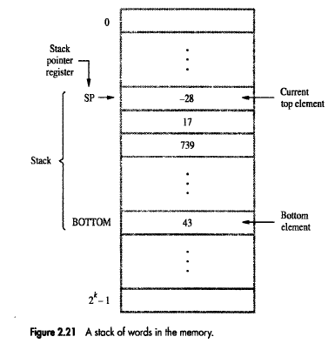

Slide 20
If we assume a byte addressable memory with 32-bit word length the push operation can be implemented as
Subtract #4,SP
Move NEWITEM,(SP)
These two instructions move the word from location NEWITEM onto the top of the STACK decrementing the stack pointer before the move.
The POP operation can be implemented as
Move (SP), ITEM
Add #4,SP
These two instructions move the top value from the stack into the location ITEM and then increment the stack pointer by 4 so that it points to the new top element. The figure shows the effect of the each of these operations on the stack.

Slide 21
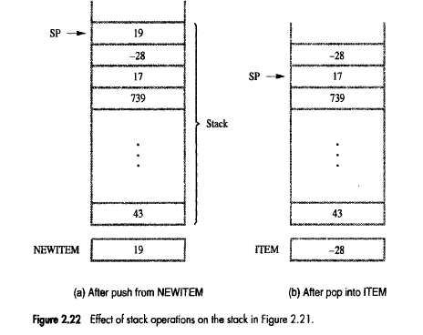

Slide 22
If the processor has the autoincrement and autodecrement addressing modes the push operation can be performed by the single instruction
MOVE NEWITEM, -(SP)
And pop operation can be performed by
MOVE (SP)+, ITEM
When a stack used in a program, it is usually allocated a fixed amount of space in the memory .
In this case we must avoid pushing an item onto the stack when the stack has reached its maximum size.
Also, we must avoid attempting to POP an item off an empty stack, which could result from a programming error.

Slide 23
Suppose that a stack runs from location 2000(bottom) .
The stack pointer is loaded initially with the address value 2004. recall that SP is decremented by 4 before new item pushed on the stack. Hence an initial value of 2004 means that the first item pushed onto the stack will be at location 2000.
To prevent either pushing an item on a full stack or popping an item off an empty stack the single instruction push and pop operations can be replaced by the instruction sequences shown in the figure.

Slide 24
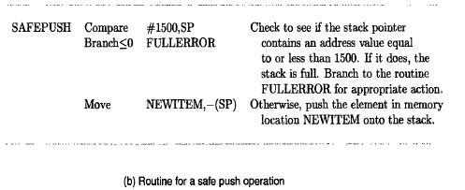
SAFE PUSH

Slide 25
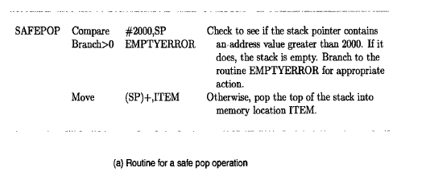
SAFEPOP

Slide 26
SUBROUTINES
In a given program, it is often necessary to perform a particular subtask many times.
A subroutine is a group of instructions, performs a particular subtask which is executed number of times. It is written separately.
The processor executes this subroutine by transferring the program control to the subroutine program.
After completion of subroutine program execution, the program control is returned back to the main program.

Slide 27
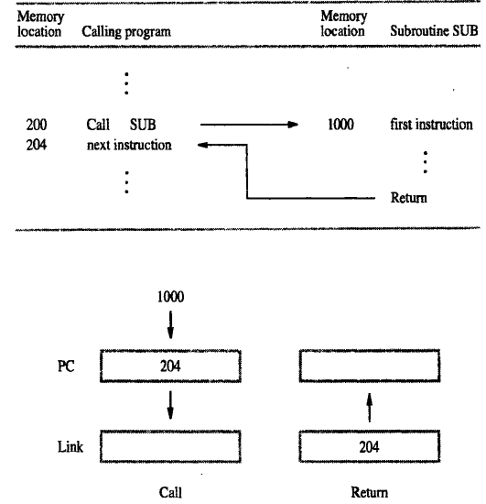

Slide 28
CALL Instruction:
The call instruction performs the following operations
Store the contents of the Program counter(PC) in the link register.
Branch to the target address specified by the instruction.
RETURN Instruction:
Loads the program counter(PC) with the contents of link register and branch to that address.

Slide 29
Subroutine Nesting
When one subroutine calls another subroutine to complete a particular task, the operation is called NESTING.
Calling program SUB1 SUB2
1 1 1
2 2 2
3 3 3
CALL SUB1 CALL SUB2 4
5 5 5
6 RET
RET

Slide 30
In this case, the return address(RA) of the second call is also stored in the link register, destroying its previous contents.
Hence it is essential to save the contents of the link register in some other location before calling another subroutine, otherwise the return address of the first subroutine will be lost.

Slide 31
Parameter Passing
When calling a subroutine, a program must provide to the subroutine the parameters , that is operands or their addresses, to be used in the computation.
Later the subroutine returns other parameters, in this case the results of the computation.
This exchange of information between a calling program and a subroutine is referred to as parameters passing.
Parameters passing may be accomplished in several ways.
The parameters may be placed in registers or in memory locations, where they can be accessed by subroutine.
Alternatively, the parameters may be placed on the processor stack.

Slide 32
Passing Parameters Through Registers.
Passing parameters through registers is straight forward and efficient.
Figure shows how the program for adding a list of numbers can be implemented as subroutine.

Slide 33
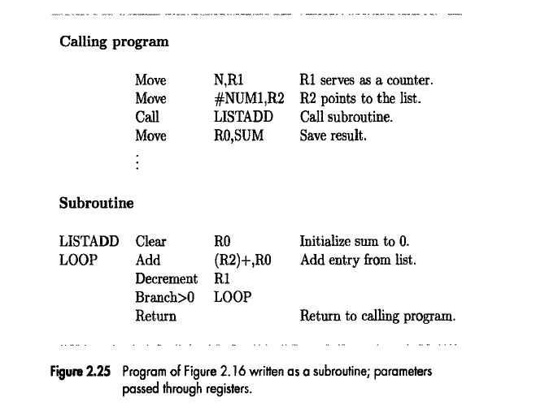

Slide 34
If many parameters are involved, there may not be enough general-purpose registers available for passing them to the subroutine.

Slide 35
The Memory System
Fundamental Concepts

Slide 36
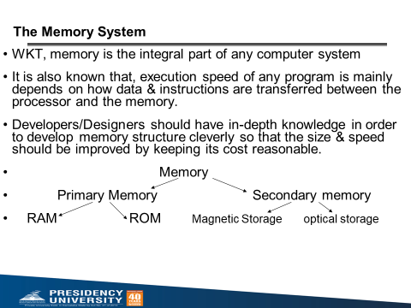

Slide 37
Some basic concepts
Maximum size of the memory of a computer is determined by the number of address lines of the processor bus.
For ex, computer having 16 address lines are capable of addressing upto 2¹⁶ = 64K memory locations.
So, in general, if there are K bit address lines, then there are 2^{K} memory locations
If the memory is byte addressable, each location of memory can store 8 bit of information.
So, memory capacity L=2^{K} locations * 8 bits/location= 2^{K} bytes

Slide 38
Some basic concepts
Maximum size of the Main Memory
byte-addressable
CPU-Main Memory Connection
Processor
k
-bit
Memory
address bus
MAR
n
-bit
data bus
Up to 2
k
MDR
addressable
locations
Word length =
n
bits
Control lines
R
/
W
( , MFC, etc.)

Slide 39
Some basic concepts
Maximum size of the memory of a computer is determined by the number of address lines of the processor bus.
For ex, computer having 16 address lines are capable of addressing upto 2¹⁶ = 64K memory locations.
So, in general, if there are K bit address lines, then there are 2^{K} memory locations
If the memory is byte addressable, each location of memory can store 8 bit of information.
So, memory capacity L=2^{K} locations * 8 bits/location= 2^{K} bytes

Slide 40
Some basic concepts(Contd.,)
Measures for the speed of a memory:
  memory access time.
  memory cycle time.
An important design issue is to provide a computer system with as large and fast a memory as possible, within a given cost target.
Several techniques to increase the effective size and speed of the memory:
  Cache memory (to increase the effective speed).
  Virtual memory (to increase the effective size).

Slide 41
The Memory System
Semiconductor RAM memories

Slide 42
Internal organization of memory chips
Each memory cell can hold one bit of information.
Memory cells are organized in the form of an array.
One row is one memory word.
All cells of a row are connected to a common line, known as the “word line”.
Word line is connected to the address decoder.
Sense/write circuits are connected to the data input/output lines of the memory chip.

Slide 43
Internal organization of memory chips (Contd.,)
7
7
1
1
0
0
W
0
•
•
•
FF
FF
A
0
W
1
•
•
•
A
1
Address
Memory
decoder
•
•
•
•
•
•
•
•
•
•
•
•
•
•
•
•
•
•
cells
A
2
A
3
W
15
•
•
•
Sense / Write
Sense / Write
Sense / Write
R
/
W
circuit
circuit
circuit
CS
Data input
/output lines:
b
7
b
1
b
0

Slide 44
Internal organization of memory chips (Contd.,)
The previous figure is an example of a very small memory circuit consisting of 16 words of 8 bits each. This is referred to as a 16 × 8 organization. The data input and the data output of each Sense/Write circuit are connected to a single bidirectional data line that can be connected to the data lines of a computer. Two control lines, R/W and CS, are provided. The R/W Read/Write) input specifies the required operation, and the CS (Chip Select) input selects a given chip in a multichip memory system.
The memory circuit stores 128 bits and requires 14 external connections for address, data, and control lines. It also needs two lines for power supply and ground connections. Consider now a slightly larger memory circuit, one that has 1K (1024) memory cells. This circuit can be organized as a 128 × 8 memory, requiring a total of 19 external connections. Alternatively, the same number of cells can be organized into a 1K×1 format. In this case, a 10-bit address is needed, but there is only one data line, resulting in 15 external

Slide 45
Read-Only Memories (ROMs)
SRAM and SDRAM chips are volatile:
  Lose the contents when the power is turned off.
Many applications need memory devices to retain contents after the power is turned off.
  For example, computer is turned on, the operating system must be loaded from the disk into the memory.
  Store instructions which would load the OS from the disk.
  Need to store these instructions so that they will not be lost after the power is turned off.
  We need to store the instructions into a non-volatile memory.
Non-volatile memory is read in the same manner as volatile memory.
  Separate writing process is needed to place information in this memory.
  Normal operation involves only reading of data, this type
  of memory is called Read-Only memory (ROM).

Slide 46
Read-Only Memories (Contd.,)
Read-Only Memory:
  Data are written into a ROM when it is manufactured.
Programmable Read-Only Memory (PROM):
  Allow the data to be loaded by a user.
  Process of inserting the data is irreversible.
  Storing information specific to a user in a ROM is expensive.
  Providing programming capability to a user may be better.
Erasable Programmable Read-Only Memory (EPROM):
  Stored data to be erased and new data to be loaded.
  Flexibility, useful during the development phase of digital systems.
  Erasable, reprogrammable ROM.
  Erasure requires exposing the ROM to UV light.

Slide 47
Read-Only Memories (Contd.,)
Electrically Erasable Programmable Read-Only Memory (EEPROM):
  To erase the contents of EPROMs, they have to be exposed to ultraviolet light.
  Physically removed from the circuit.
  EEPROMs the contents can be stored and erased electrically.
Flash memory:
  Has similar approach to EEPROM.
  Read the contents of a single cell, but write the contents of an entire block of cells.
  Flash devices have greater density.
    Higher capacity and low storage cost per bit.
  Power consumption of flash memory is very low, making it attractive for use in equipment that is battery-driven.
  Single flash chips are not sufficiently large, so
  larger memory modules are implemented using
  flash cards and flash drives.

Slide 48
Speed, Size, and Cost
A big challenge in the design of a computer system is to provide a sufficiently large memory, with a reasonable speed at an affordable cost.
Static RAM:
  Very fast, but expensive, because a basic SRAM cell has a complex circuit making it impossible to pack a large number of cells onto a single chip.
Dynamic RAM:
  Simpler basic cell circuit, hence are much less expensive, but significantly slower than SRAMs.
Magnetic disks:
  Storage provided by DRAMs is higher than SRAMs, but is still less than what is necessary.
  Secondary storage such as magnetic disks provide a large amount
  of storage, but is much slower than DRAMs.

Slide 49

Memory Hierarchy
Pr
ocessor
Fastest access is to the data held in
processor registers. Registers are at
the top of the memory hierarchy.
Relatively small amount of memory that
can be implemented on the processor
chip. This is processor cache.
Two levels of cache. Level 1 (L1) cache
is on the processor chip. Level 2 (L2)
cache is in between main memory and
processor.
Next level is main memory, implemented
as SIMMs. Much larger, but much slower
than cache memory.
Next level is magnetic disks. Huge amount
of inexepensive storage.
Speed of memory access is critical, the
idea is to bring instructions and data
that will be used in the near future as
close to the processor as possible.
Re
gisters
Increasing
Increasing
Increasing
size
speed
cost per bit
Primary
L1
cache
Secondary
L2
cache
Main
memory
Magnetic disk
secondary
memory

Slide 50
Cache Memories
Processor is much faster than the main memory.
  As a result, the processor has to spend much of its time waiting while instructions and data are being fetched from the main memory.
  Major obstacle towards achieving good performance.
Speed of the main memory cannot be increased beyond a certain point.
Cache memory is an architectural arrangement which makes the main memory appear faster to the processor than it really is.
Cache memory is based on the property of computer programs known as “locality of reference”.

Slide 51
Locality of Reference
Analysis of programs indicates that many instructions in localized areas of a program are executed repeatedly during some period of time, while the others are accessed relatively less frequently.
  These instructions may be the ones in a loop, nested loop or few procedures calling each other repeatedly.
  This is called “locality of reference”.
Temporal locality of reference:
  Recently executed instruction is likely to be executed again very soon.
Spatial locality of reference:
  Instructions with addresses close to a recently instruction are likely To be executed soon.

Slide 52
Cache memories
Processor
Cache
Main
memory
Processor issues a Read request, a block of words is transferred from the main memory to the cache, one word at a time.
Subsequent references to the data in this block of words are found in the cache.
At any given time, only some blocks in the main memory are held in the cache. Which blocks in the main memory are in the cache is determined by a “mapping function”.
When the cache is full, and a block of words needs to be transferred
from the main memory, some block of words in the cache must be
replaced. This is determined by a “replacement algorithm”.

Slide 53
Cache hit
Existence of a cache is transparent to the processor. The processor issues Read and
Write requests in the same manner.
If the data is in the cache it is called a Read or Write hit.
Read hit:
  The data is obtained from the cache.
Write hit:
  Cache has a replica of the contents of the main memory.
  Contents of the cache and the main memory may be updated simultaneously. This is the write-through protocol.
  Update the contents of the cache, and mark it as updated by setting a bit known as the dirty bit or modified bit. The contents of the main memory are updated when this block is replaced. This is write-back or copy-back protocol.

Slide 54
Cache miss
If the data is not present in the cache, then a Read miss or Write miss occurs.
Read miss:
  Block of words containing this requested word is transferred from the memory.
  After the block is transferred, the desired word is forwarded to the processor.
  The desired word may also be forwarded to the processor as soon as it is transferred without waiting for the entire block to be transferred. This is called load-through or early-restart.
Write-miss:
  Write-through protocol is used, then the contents of the main memory are updated directly.
  If write-back protocol is used, the block containing the
  addressed word is first brought into the cache. The desired word
  is overwritten with new information.

Slide 55
Cache Coherence Problem
A bit called as “valid bit” is provided for each block.
If the block contains valid data, then the bit is set to 1, else it is 0.
Valid bits are set to 0, when the power is just turned on.
When a block is loaded into the cache for the first time, the valid bit is set to 1.
Data transfers between main memory and disk occur directly bypassing the cache.
When the data on a disk changes, the main memory block is also updated.
However, if the data is also resident in the cache, then the valid bit is set to 0.
What happens if the data in the disk and main memory changes and the write-back protocol is being used?
In this case, the data in the cache may also have changed and is indicated by the dirty bit.
The copies of the data in the cache, and the main memory are different. This is called the cache coherence problem.
One option is to force a write-back before the main memory is updated from the disk.

Slide 56
Mapping functions
Mapping functions determine how memory blocks are placed in the cache.
A simple processor example:
  Cache consisting of 128 blocks of 16 words each.
  Total size of cache is 2048 (2K) words.
  Main memory is addressable by a 16-bit address.
  Main memory has 64K words.
  Main memory has 4K blocks of 16 words each.
Three mapping functions:
  Direct mapping
  Associative mapping
  Set-associative mapping.

Slide 57
Direct mapping
Main
Block j of the main memory maps to j modulo 128 of
the cache. 0 maps to 0, 129 maps to 1.
More than one memory block is mapped onto the same
position in the cache.
May lead to contention for cache blocks even if the
cache is not full.
Resolve the contention by allowing new block to
replace the old block, leading to a trivial replacement
algorithm.
Memory address is divided into three fields:
- Low order 4 bits determine one of the 16
words in a block.
- When a new block is brought into the cache,
the the next 7 bits determine which cache
block this new block is placed in.
- High order 5 bits determine which of the possible
32 blocks is currently present in the cache. These
are tag bits.
Simple to implement but not very flexible.
memory
Block 0
Cache
Block 1
tag
Block 0
tag
Block 1
Block 127
Block 128
tag
Block 127
Block 129
T
ag
Block
W
ord
Block 255
5
7
4
Block 256
Main memory address
Block 257
Block 4095

Slide 58
Set-Associative mapping
Cache
Main
Blocks of cache are grouped into sets.
Mapping function allows a block of the main
memory to reside in any block of a specific set.
Divide the cache into 64 sets, with two blocks per set.
Memory block 0, 64, 128 etc. map to block 0, and they
can occupy either of the two positions.
Memory address is divided into three fields:
- 6 bit field determines the set number.
- High order 6 bit fields are compared to the tag
fields of the two blocks in a set.
Set-associative mapping combination of direct and
associative mapping.
Number of blocks per set is a design parameter.
- One extreme is to have all the blocks in one set,
requiring no set bits (fully associative mapping).
- Other extreme is to have one block per set, is
the same as direct mapping.
memory
Block 0
tag
Block 0
Block 1
tag
Block 1
tag
Block 2
tag
Block 3
Block 63
Block 64
tag
Block 126
Block 65
tag
Block 127
T
ag
Block
W
ord
Block 127
5
7
4
Block 128
Main memory address
Block 129
Block 4095

Slide 59
Associative mapping
Main
Block 0
memory
Main memory block can be placed into any cache
position.
Memory address is divided into two fields:
- Low order 4 bits identify the word within a block.
- High order 12 bits or tag bits identify a memory
block when it is resident in the cache.
Flexible, and uses cache space efficiently.
Replacement algorithms can be used to replace an
existing block in the cache when the cache is full.
Cost is higher than direct-mapped cache because of
the need to search all 128 patterns to determine
whether a given block is in the cache.
Cache
Block 1
tag
Block 0
tag
Block 1
Block 127
Block 128
tag
Block 127
Block 129
Tag
Word
Block 255
12
4
Block 256
Main memory address
Block 257
Block 4095

